Slide 1
Good pensions for Europe
10th anniversary of the Romanian Pension Funds' Association - APAPR
Bucharest, 10 October 2017
Matti Leppälä, Secretary General
PensionsEurope

Slide 2
Who do we represent
Leading European voice for pensions
24 member associations:
19 EU Member States (AT, BE, BG, DE, EE, ES, FI, FR, HU, HR, IE, IT, LT, LU, NL, PT, RO, SE, UK)
non-EU (CH, IS, NO)
Our Members manage pension assets of over € 4 trn for more than 110 million European citizens
+ 25 C&S members
+ CEEC forum
+ MAG

Slide 3
Global megatrends will shape the future of pensions
Longer life expectancy and changing demography
  According to the OECD the old-age dependency ratio, which is the ratio of older dependents (people older than 64) to the working age population will increase from 28% in 2015 to 51% in 2050
  The 1st pillar PAYG pensions will face tremendous challenges.
  Financial and social sustainability
  Sustainability of Public finances
Structural changes in the labor market
  More self-employed workers – Automatic enrolment to pension schemes needed in order to safeguard adequate and sustainable pensions?
Technological breakthroughs
  Easy-to-use applications to follow up all pension savings, returns, costs etc.
Growing interest in ESG factors
  Impact on investment portfolios and reporting standard

Slide 4
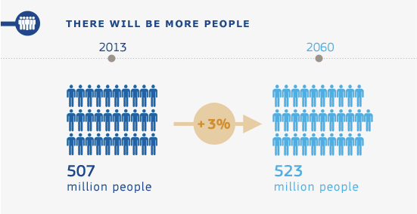
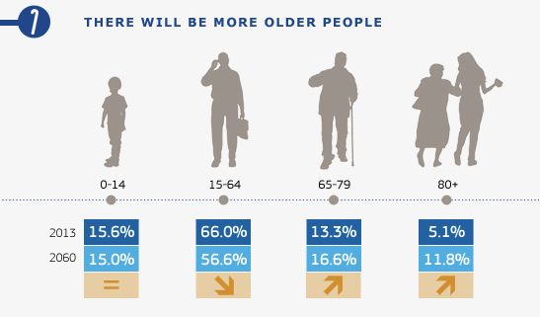
Source: EC 2015 Ageing report

Slide 5
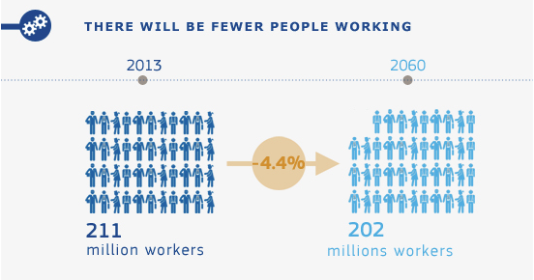
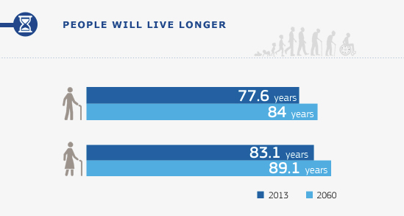
Source: EC 2015 Ageing report

Slide 6
The real challenge is to find the right match between sustainability and adequacy.

Slide 7
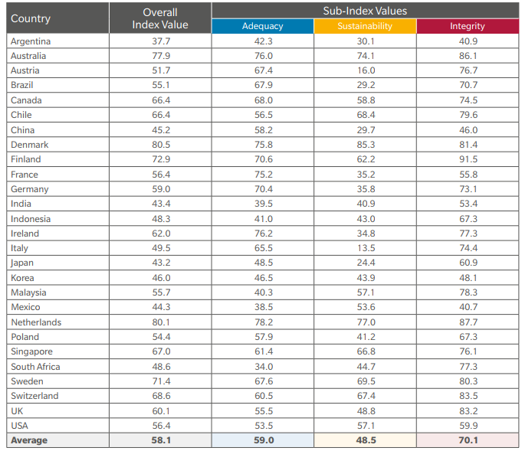
Which is the best pension system?
Melbourne Mercer Global Pension Index considers adequacy, sustainability and integrity in 27 Countries
3
What do the best pension systems have in common?
1
They are mixed systems: there is a PAYG tier, but also a mandatory or quasi-mandatory tier that is funded!
2
Notes:
Having a funded system doesn’t mean to be the best, but only funded systems are the best.
For more information on the sub-index values see: https://www.globalpensionindex.com/about-the-index/executive-summary-2016/

Slide 8
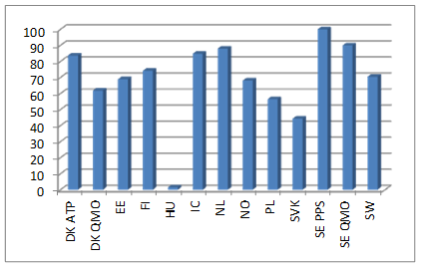
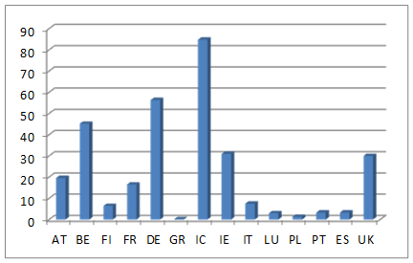
Coverage: mandatory vs voluntary
In the Member States where the occupational system is mandatory or quasi-mandatory, the coverage is as follows (in % of working population, OECD 2011):
In the Member States where the occupational system is voluntary the coverage is as follows (in % of working population, OECD 2011):
Notes:
Quasi-mandatory:There is no obligation by law to become a member of a pension fund. But if the social partners decide to provide a pension scheme for their employees, the government can make a pension scheme mandatory for an entire sector or profession
Coverage different in several Member States, differences between mandatory and voluntary. Now in UK: auto-enrollment which increases coverage ratio.

Slide 9
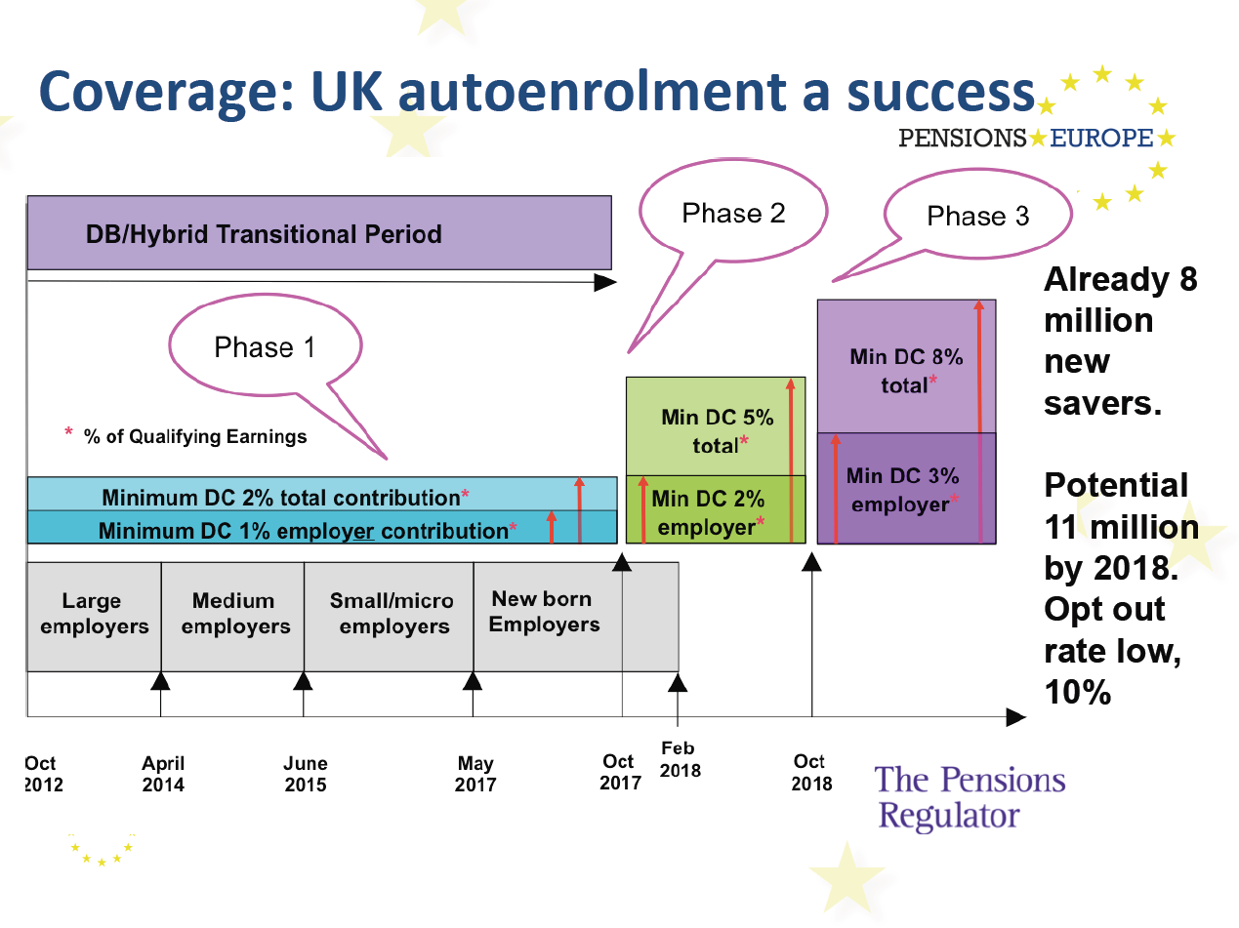

Slide 10
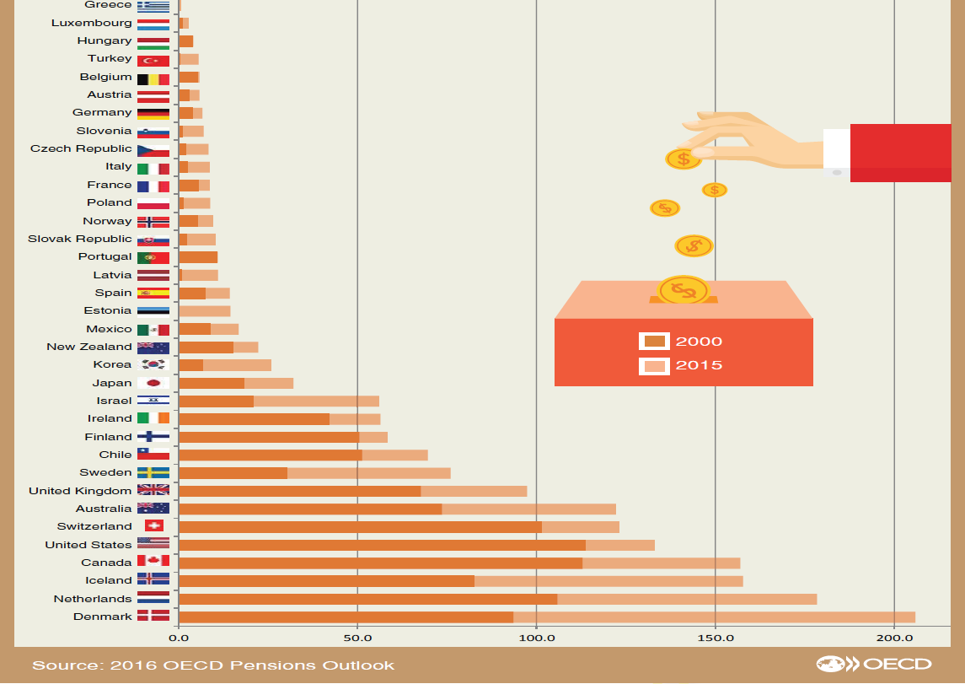
Pension funds as total of the GDP

Slide 11
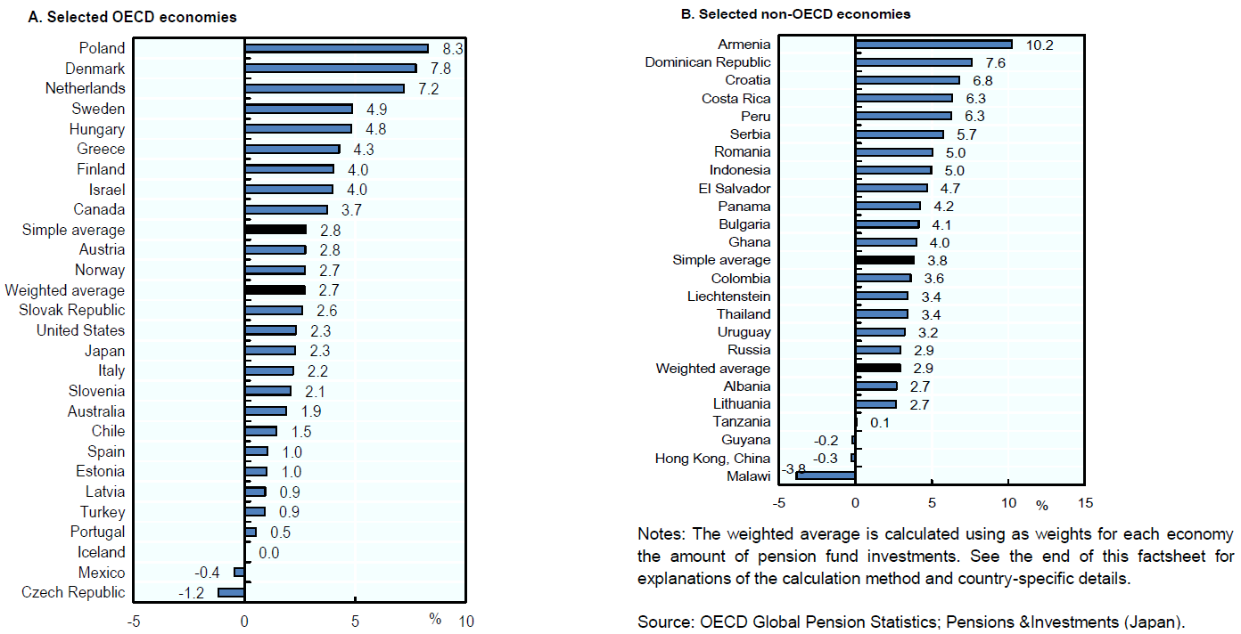
Pension funds’ real net investment returns

Slide 12
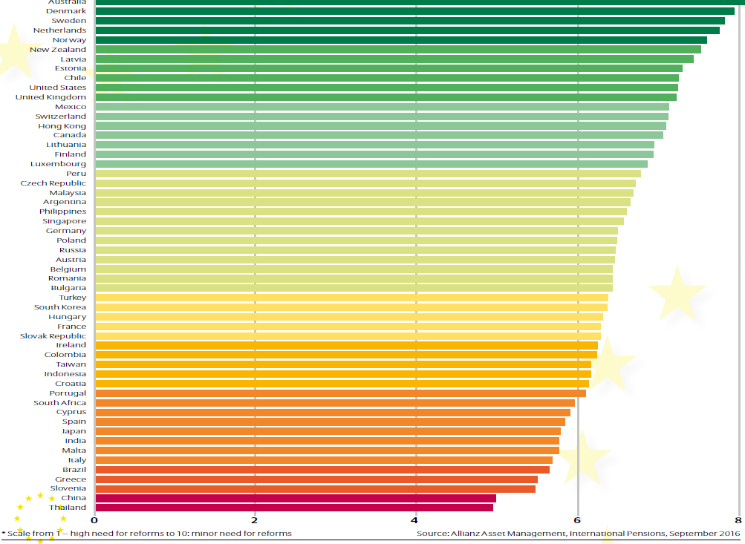
Allianz Pension Sustainability Index 2016

Slide 13
What PensionsEurope stands for
We believe that private pension saving should be encouraged to compensate for potential lower state pension benefits. In particular we support a regulatory environment encouraging workplace pension membership. Work based pensions indeed offer:
Economies of scale in governance, administration and asset management;
Risk pooling and often intergenerational risk-sharing;
Often not-for profit;
Members of work based pension schemes often benefit from a contribution paid by the employer;
Wide-scale coverage due to mandatory participation, sector-wide participation based on collective agreement and soft-compulsion elements such as auto-enrolment;
Good governance and alignment of interest due to participation of the main stakeholders.

Slide 14
Modern pension solutions:
“Combining the best of the 2 worlds”
Risk
employer
Pure DB
DB contribution based
Various hybrids
DC with guarantees
Pure DC
Risk employee
Notes:
Due to the above mentioned current economic and social circumstances there is pressure on DB occupational pension systems. In some cases the decision has been made to phase out the DB schemes, in other cases social partners have decided to modify the existing DB schemes to a more modern design with greater flexibility and introducing the possibility of individual choices in relation to certain elements. In a lot of jurisdictions this has led to satisfactory results, in some others there is still ongoing discussion on the feasibility of DB schemes for the future.
A feasible (adequate and sustainable) supplementary occupational pension scheme for the future could have the following characteristics:
- Part of labor conditions agreed by employer(s) and employee(s), i.e. collective agreements
- Transparent, simple and complete (including clearly communicated risk sharing)
- Ambition to index to inflation (or partial inflation) – but not necessarily a statutory requirement
- Financially affordable
- Adjustable to exogenous shocks via risk sharing
- Well balanced for all stakeholders
- The possibility for individualizing and custom fit when desirable by employers and employees
- Part of second pillar as a supplement to the first statutory pillar
- Create pension awareness.
- Help social partners to understand.
- More information/better communication.
PensionsEurope is exploring through its committtes, working groups (..) how to best contribute to the evolution of pensions looking at which elements of DC schemes could play a role in future sophisticated DB systems and vice versa.
Such a combination could link the best of the two worlds, where the risk is not entirely shifted to the individual, but where collective elements and sharing of certain risks could contribute to adequate, reliable and sustainable pensions. This means that pure DB would be more like hybrid DB, but also pure DC could develop into more hybrid DC.
Nonetheless, an ideal ‘one-size-fits-all’ DB contract doesn’t exist. Every occupational pension scheme should take into account the context of the national pension systems and the different social aspects in different Member States.
Some countries are searching for a compromise between pure DB and pure DC. They try to combine the best of the two worlds.
Collective Defined Contribution (CDC) plans in the Netherlands
In the Netherlands, in the past, so-called Collective Defined Contributions (CDC) schemes have appeared. In the Dutch occupational pension system, Collective Defined Contribution (CDC) pension agreements are legally a form of Defined Benefit (DB) schemes. In a CDC pension agreement, entitlements accrued in past years are treated as regular DB pension entitlements. However, the contribution rate (or premium) is set at a fixed level, mostly for several years. This means that it is not possible for the pension fund to increase the contribution rate or to ask a lump sum to generate an additional inflow of contributions, for instance to increase buffers. Moreover, if the fixed contribution rate is too low to cover the level of new pension accrual in a given year, the level of new pension accrual is adjusted downwards and the contribution rate does not change. There is an ambition for a certain level of pension accrual. Thus, certain risks are shifted to the employee, requiring transparent disclosure of the risks involved. For standard DB agreements, in such a case the contribution rate would increase. In the more recent pension discussion, the Netherlands is (slowly) heading towards a system, where the best of the DB world and the DC world are combined. This means that the risks are still shared in a collective system while the system is shock resistant (financial and demographic) and the transition from an old DB/CDC system towards a new system with collectively managed personal accounts and/or the pension ambition contract happens in a smooth way. An important element in any adjustment of the DB and the DC world is ultimately the communication towards the scheme members.
The setting up of a Defined Benefit plan with a contribution orientated benefit formula by a German Pensionskasse
Due to the provisions of the German Occupational Pensions Act, solely pension plans operating on a defined benefit basis are considered as Occupational Retirement Provision in Germany. (Pure) DC plans are classified as private pensions of the third pillar. Specific hybrid pension plans that include both DB and DC elements, like for example defined contribution promises with a guaranteed minimum benefit or contribution orientated pension promises, are designated as occupational pensions by the German Occupational Pensions Act.
The Höchster Pensionskasse VVaG, a German institution for occupational retirement provision (IORP), is providing occupational pensions (lifetime annuities) solely according to a contribution orientated benefit formula and was founded in 1998 as occupational pension provider for a joint venture entity of two large German companies of the chemical industry that wanted to offer transparent, attractive and sustainable supplementary occupational pensions to their employees. The contribution orientated pension formula used provides for those qualities and for the opportunity to offer calculable defined benefits. The scheme is funded by contributions of the employer and its employees. The calculation of the acquired retirement benefits is based on the level of contributions paid and executed according to a defined benefit formula equivalent to the age and other biometrical aspects of the respective employee (monthly basis) referring to the event of the payment of the contributions. That leads to a maximum of planning security and transparency for the IORP as well as for the respective employee and also for the employer, who is responsible for the given pension promise because a statutory liability. Furthermore, such a calculation formula leads to a maximum of flexibility. The Pensionskasse is designed as a multi-employer IORP. For these reasons, the statutes and bylaws of the Pensionskasse do not stipulate a fixed contribution amount. Every employer is free to decide about the level of contributions paid and about the decision to involve its employees by the payment of own contributions as long as the level of the employers contributions is at least as high as the contribution level of the employee. Furthermore, there is no link to any kind of statutory retirement age because the defined calculation formula is designed on a three-dimensional basis. The benefit formula of the scheme in general refers to an age at expiry of financing of 65. The benefits of people that decide to apply for retirement benefits earlier are calculated with a reduction. Employees that decide to work longer will continue to contribute to the scheme and will receive retirement benefits calculated with additional surcharges. Due to tax reasons, people are not allowed to apply for old age provisions before the age of 62. In case of the termination of the employment contract, outgoing workers are furthermore allowed to continue contributing to the scheme by the payment of own contributions or can decide to transfer the capital value of their acquired entitlements to another pension scheme (portability).
The Höchster Pensionskasse operates as a mutual insurance association (Versicherungsverein auf Gegenseitigkeit). According to the legal framework of the German Insurance Supervision Act, the Pensionskasse is regulated by its Supervisory Authority which leads to a maximum level of co-determination due to the fact that at least 50 percent of the members of the senior representative body are appointed by the members/their representatives. This arrangement also leads to a high level of transparency in relation to cost. Furthermore, the Pensionskasse is not allowed to charge any acquisition cost loadings for the intermediation of insurance contracts and/or to pay any fees for intermediation or conclusion of such contracts. In 2015, the level of administration costs in relation to the contributions received is about 1 %. Currently, the Höchster Pensionskasse VVaG has almost 500 sponsoring undertakings and more than 145.000 members and beneficiaries.

Slide 15
PensionsEurope DC initiatives
2015-2017

Slide 16
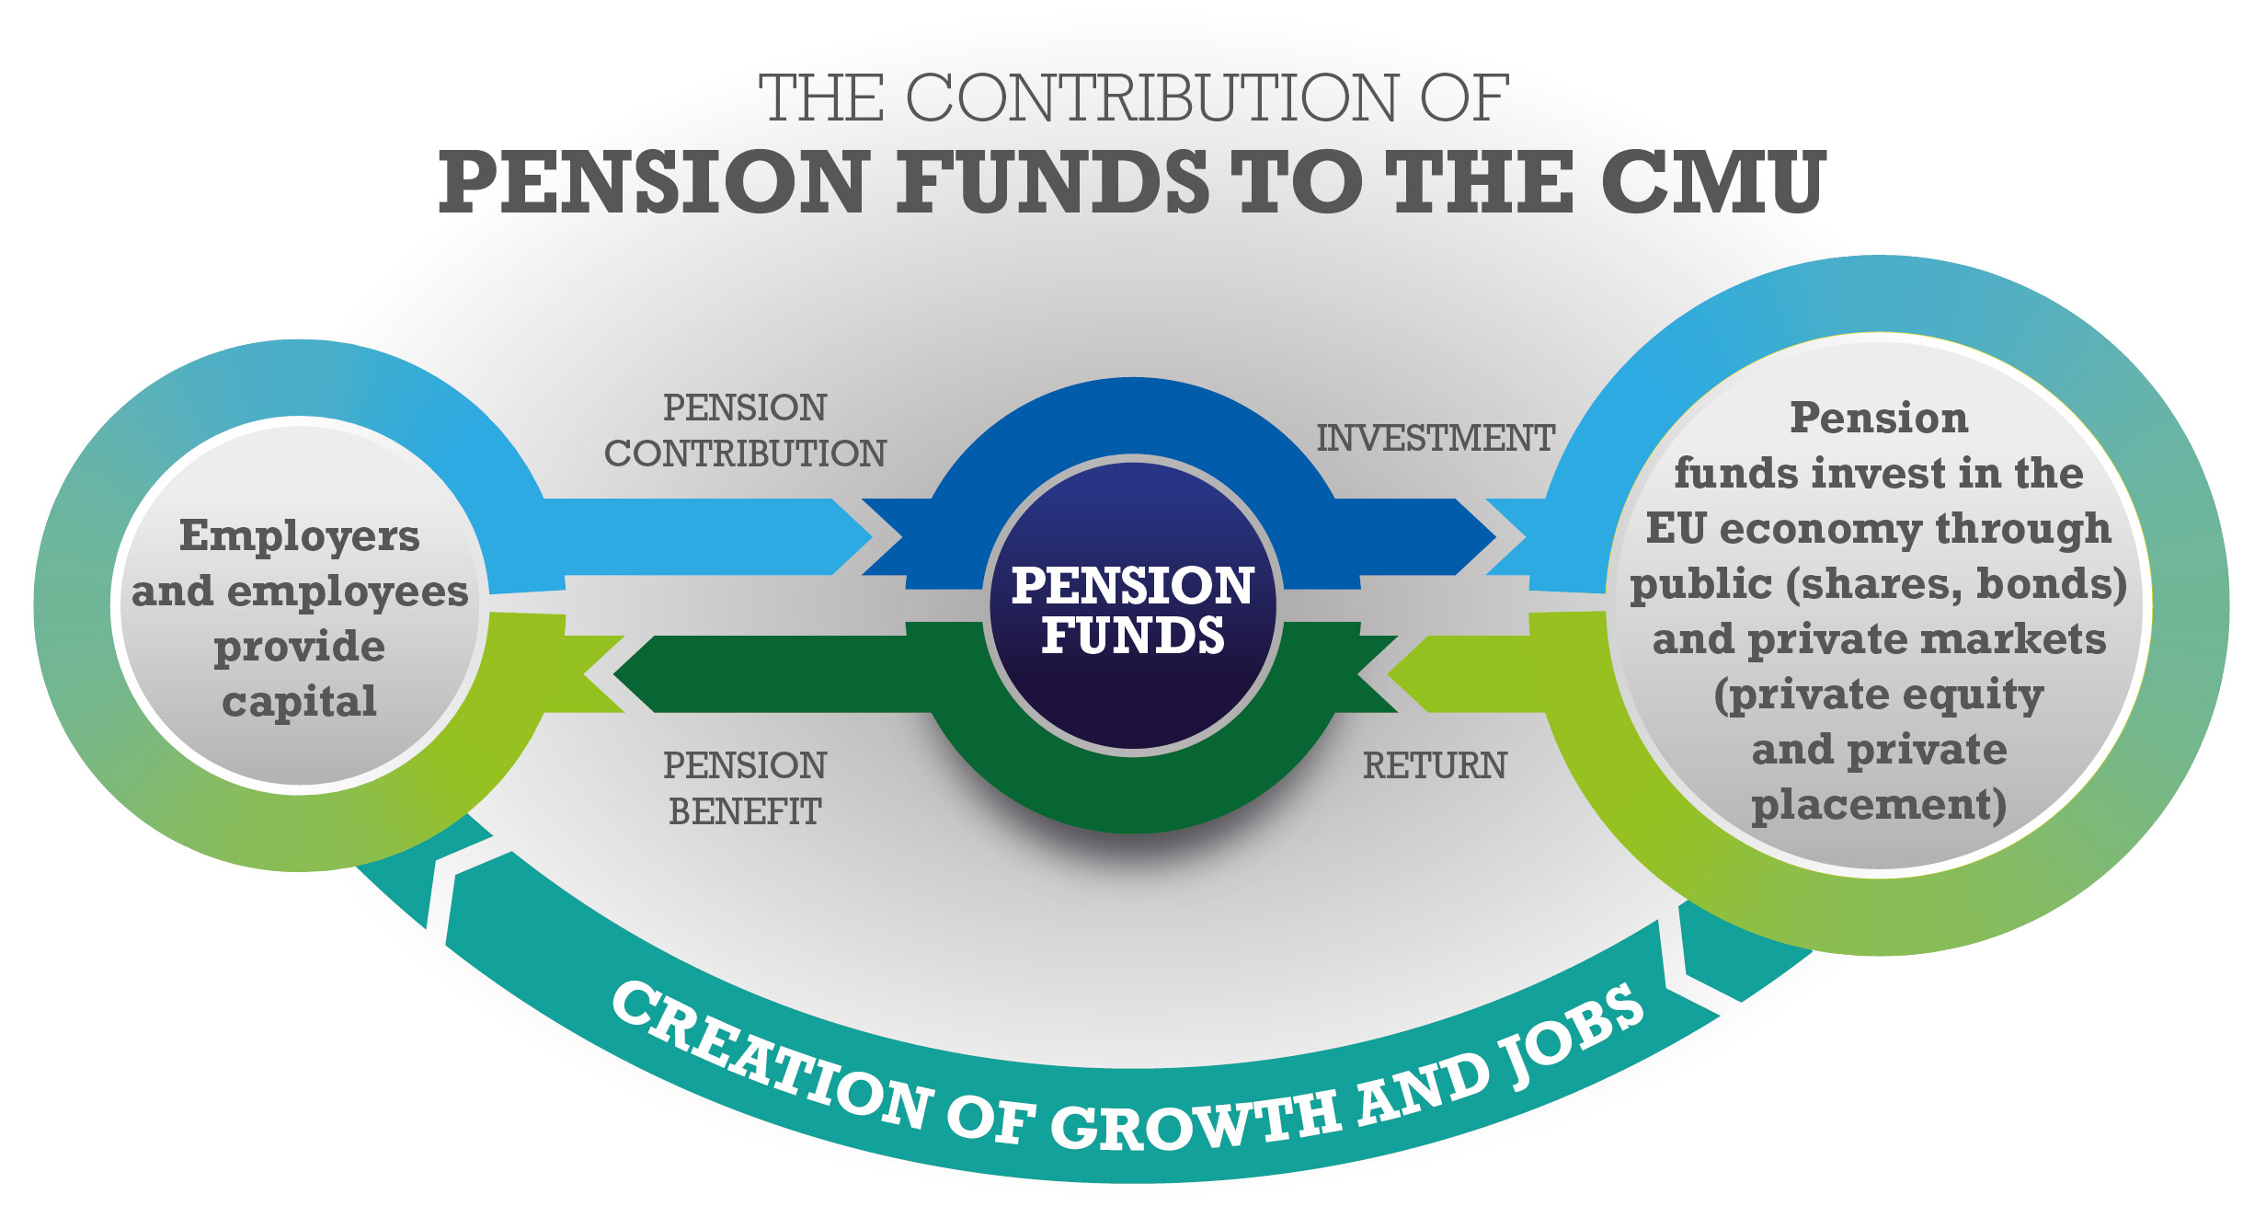
Capital Markets Union
Notes:
Background and context
On 30 September the European Commission adopted the ‘Action Plan on Building a Capital Markets Union’. As part of the EU Investment Plan, the Capital Markets Union should address structural reform of the European capital markets.
According to the European Commission, in various CMU documents:
“Stronger capital markets will complement Europe’s strong tradition of bank financing, and will:
Unlock more investment from the EU and the rest of the world;
Better connect financing to investment projects across the EU;
Make the financial system more stable;
Deepen financial integration and increase competition.”
About the Action Plan
The Action Plan presents a range of steps to improve the integration and functioning of capital markets in Europe: “There is no single measure that will deliver a Capital Markets Union. Instead there will be a range of steps whose impact will cumulatively be significant. The Commission will take forward measures to remove the barriers which stand between investors' money and investment opportunities, and overcome the obstacles which prevent businesses from reaching investors.” (Action Plan)
The CMU Action Plan builds upon the Green Paper. According to the European Commission the responses to the Green Paper confirm broad support for the project, as well as support for the priorities of the Commission.
The Action Plan provides a list of 33 actions and an indicative timeline. Some actions are very concrete and call for action in 2015, others require more study or are to be addressed further along the road. Some actions require legislation, others don’t. The CMU should be in place by 2019. The Commission will assess achievements and re-assess priorities in 2017.
What is the link between CMU and the Investment Plan? The CMU is part of the third pillar of the Investment Plan as it consists of structural reforms to make Europe a more attractive place for investment and remove regulatory bottlenecks. According to the European Commission the CMU “supports and complements the Investment Plan for Europe”.
Key PensionsEurope’s points on the CMU
Pension funds are – together with banks, fund managers and insurance companies – the EU’s key institutional investors and providers of capital. PensionsEurope’s members provide workplace pensions of about 70 million citizens and represent approximately €3.5 trillion of assets.
PensionsEurope strongly supports the European Commission’s vision of a Capital Markets Union (CMU). Pension funds – and their members - have much to gain from a CMU that makes it easier to invest for the long term and across borders.
Pension funds invest as they think best so they can pay pensions to their members. It is up to national governments and the EU to create attractive and appropriate investment opportunities for pension funds, not for pension funds to amend their investment strategies simply to align them with public policy objectives.
60 per cent of EU citizens have no access to workplace pensions. Helping these people to save will help build up Europe’s pool of capital for investment.
First analysis
In the Action Plan, the European Commission recognizes the role of pension funds in capital markets and as long-term investors. The concrete actions could potentially deliver a better match between pension fund capital and investment opportunities, to remove cross-border investment barriers and bring down the costs of investments.
Key issues are:
Proposal for a regulation on simple, transparent and standardised (STS) securitisations (2015);
Proposal to modernise the Prospectus Directive (2015);
Investor security, e.g. insolvency, securities ownership;
Review of EU corporate bond markets (2017);
Consultation on a pan-European covered bond framework (2015);
Assessment of the case for a policy framework to establish European personal pensions;
Development of capital markets in all 28 Member States and further removing cross-border investment barriers, Report on national barriers to the free movement of capital, Study on discriminatory tax obstacles to cross-border investment by pension funds and life insurers (2017);
Call for evidence on the cumulative impact of the EU financial reform (2015).
So, what is missing in the CMU from pension funds perspective?
In its response to the Green Paper, PensionsEurope emphasized the broader context of investment in Europe and the relevance of the impact of financial market regulation such as EMIR, the impact of a possible FTT and the impact of monetary policy / QE on pension funds;
The European Commission has announced an adjustment of the Solvency II calibration for insurers’ investment in infrastructure. In its response to the Green Paper, PensionsEurope suggested to consider tailor-made actions to improve the attractiveness of infrastructure and other long-term investments as asset classes for pension funds;
Promotion of saving through a diverse landscape of workplace pensions - the majority of people in Europe do not have yet a workplace pension. Pension funds provide an adequate retirement income and at the same time they contribute to the European economy as institutional investors. Earlier this year PensionsEurope stressed that the European Commission could further promote workplace pensions within the CMU Action Plan.
We note that building a genuine European Capital Markets Union is a long-term project, which needs to be built step by step and taking into account the diversity of the pension fund landscape in Europe. Only hereby can the CMU reach its full potential.

Slide 17
PEPP (EC proposal June 2017)
The PEPP is a voluntary 2nd regime personal pension scheme (3rd pillar) that will offer consumers a new pan-European option to save for retirement.
Regulation focusing on harmonization of product features and information disclosure requirements
Will this proposal lead to a measurable growth of the number of EU citizens that save for adequate pensions?
Is there any risk of substitution effect? (shift from 2nd to 3rd pillar)

Slide 18
Sustainable Finance
A ‘High-Level Expert Group’ will deliver recommendations to promote sustainable finance in December 2017. It tackles all actors and processes of the financial system, not just ESG investments. Legislative proposals will follow in 2018.
Pension funds already engage in ESG investing, but diversity in approaches due to differences in the role and governance of pension funds.
Initiatives that may come our way:
  Incorporating ESG into stress tests
  Including ESG in harmonized definition of fiduciary duties
  Reporting and governance requirements
PensionsEurope supports a bigger focus on sustainability, but measures should be practical and proportional.

Slide 19
Good pension systems and reforms
Prerequisites for all pension systems: “Effective central government, fiscal stability, economic growth, well-established financial markets, and adequate public and government understanding of and trust in them” (Barr, 2002)
Pension funds play an important part in economic growth and financial markets.
Funded pension are vital for future pensions as public pension will be lower than before.
Good pension reforms are based on in depth analysis and long-term goals on adequacy and sustainability.

Slide 20
Contacts
Matti Leppälä, Secretary General/CEO
PensionsEurope
Koningsstraat 97 Rue Royale
1000 Brussels
Tel.: +32 2 289 14 14
www.pensionseurope.eu

